Slide 1
Influence of ion-ion interactions on solute transport in charged nanofiltration membranes
Laurianne Lair, Jonathan Ouiment, Zhicheng Lu, Shammah Lilonfe, Molly Dougher
12.2.24

Slide 2
Project overview
Phillip Lab
NF270 membrane.
NaCl, CaCl₂, LaCl₃ .
Most experiments have been conducted; however, the data remains to be analyzed.
Raw diafiltration data can be found in the box drive.
Conduct remaining experiments determined by MBDoE.
Dowling lab
Model hierarchy
Derive concentration polarization equation for multicomponent system.
Derive solute flux equation with diffusion + convection + electromigration.
Model-based design of experiments
What is the optimized experiment?
What is the minimum number of experiments needed to estimate the model?
In retrospect, which experiments should have been prioritized?

Slide 3
Timeline
January:
Derive concentration polarization equation model extension (Laurianne and Molly).
Derive solute flux with diffusion + convection + electromigration (Laurianne).
Integrate multicomponent calibration curve into analysis code (Zhicheng and Shammah).
Run DATA2 code for all of the experiments we have so far using the multicomponent calibration curve (Zhicheng).
February:
Extend DATA2 model to account for electromigration - solute flux accounting for all three terms (Zhicheng).
Implement the extension into the framework (Zhicheng).
Run analysis for the existing data (Zhicheng).

Slide 4
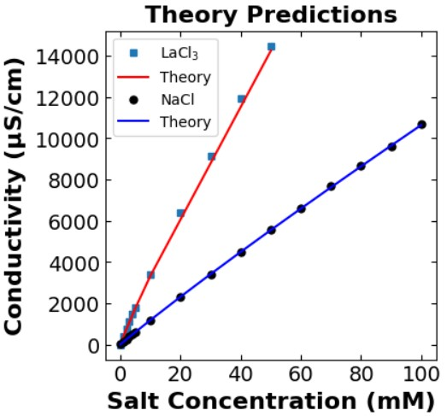
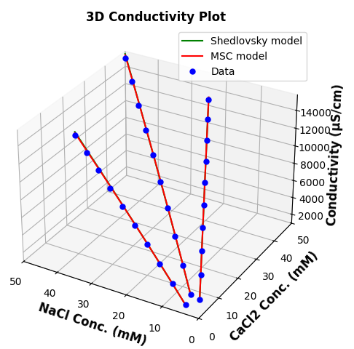
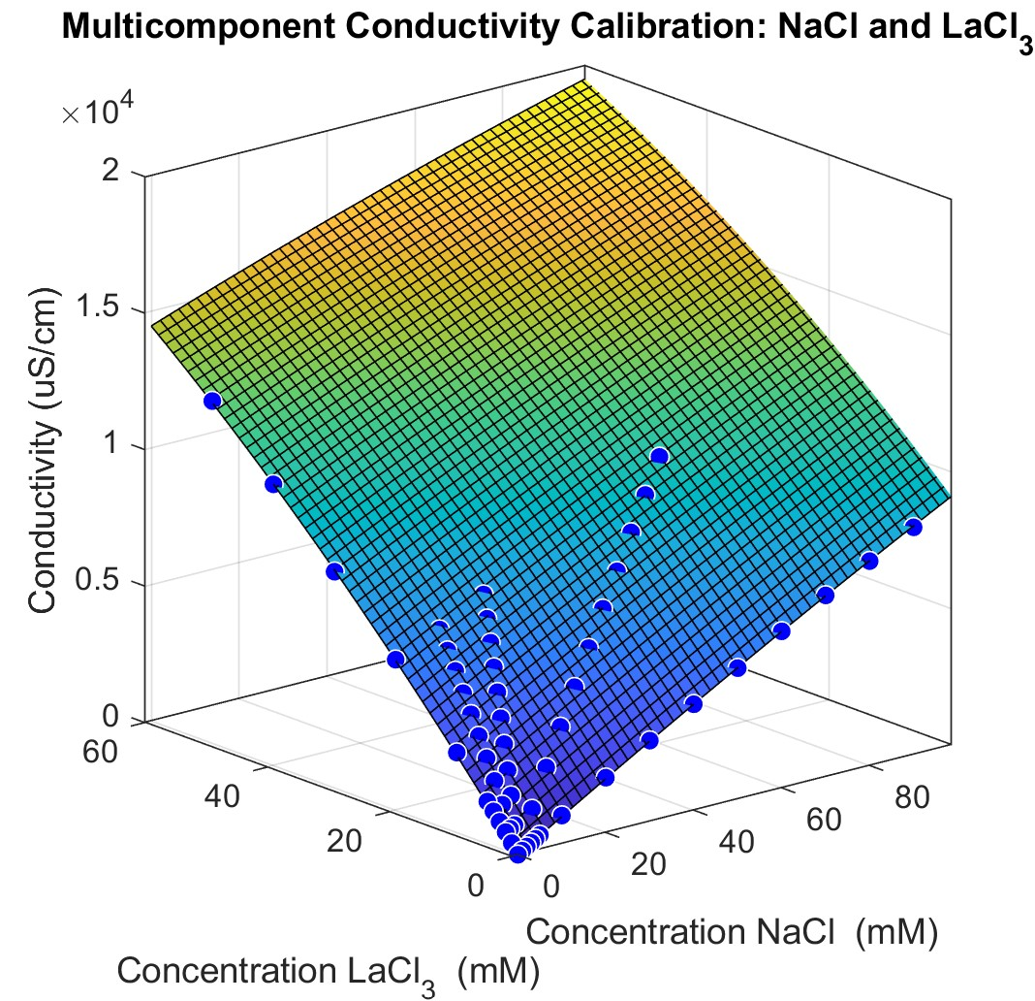
Integrate multicomponent calibration curve into the data analysis code
Combining experimental data with theoretical predictions equip us to asses complex systems:
Shammah – Single salt calibration curve analysis: theory fits with experiment.
Shammah – multicomponent calibration curve analysis: complete with other salt combinations.

Slide 5
Timeline
March:
Compile model selection results using AIC (Zhicheng).
Analyze different candidate 3-salt experiments (Zhicheng and Laurianne).
Draft the methods and introduction sections for the manuscript (Laurianne).
Identify which journal to publish – Nature? (Laurianne).
April:
Execute 3-salt experiments on diafiltration apparatus (Laurianne).
Analyze 3-salt experiments (Zhicheng and Laurianne).
Make final figures (Laurianne and Zhicheng).
Outline the results and discussion sections (Laurianne).
May:
Complete draft and submit manuscript (Team effort).

Slide 6
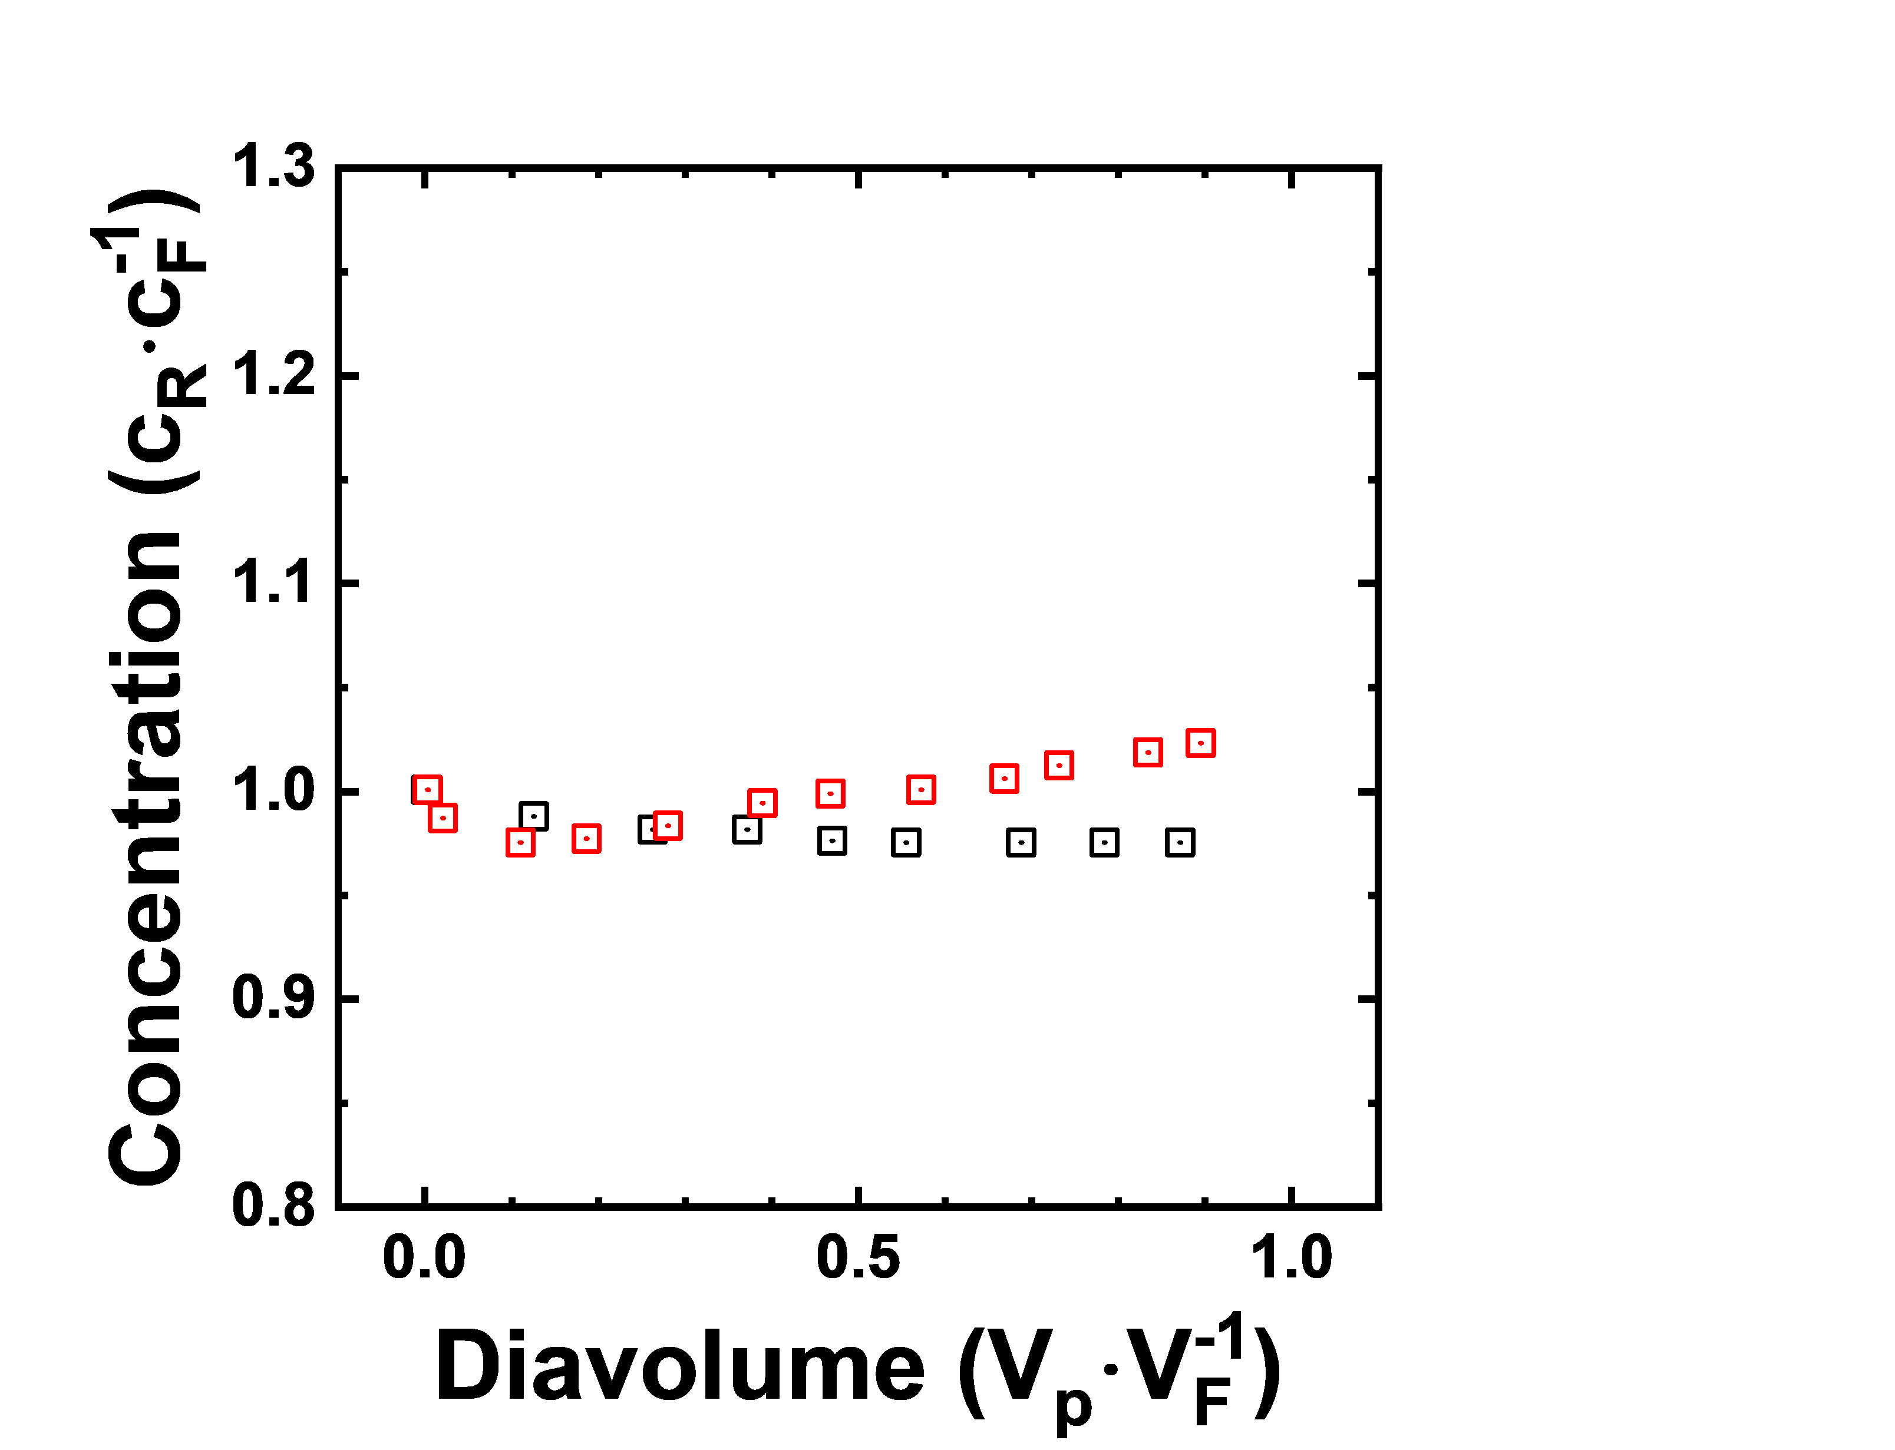
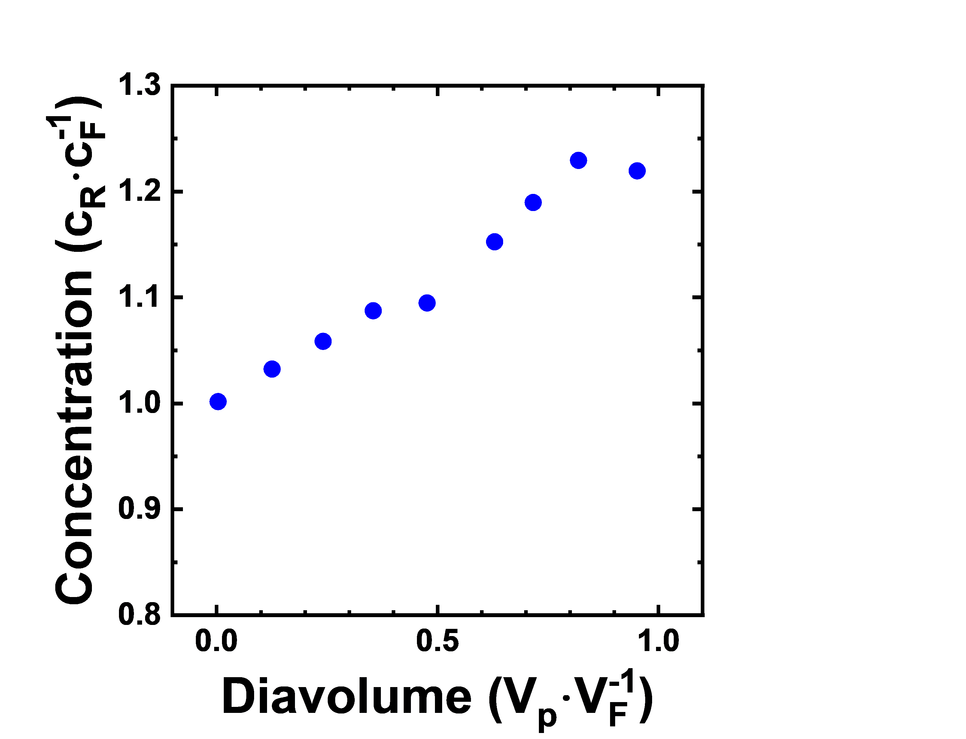
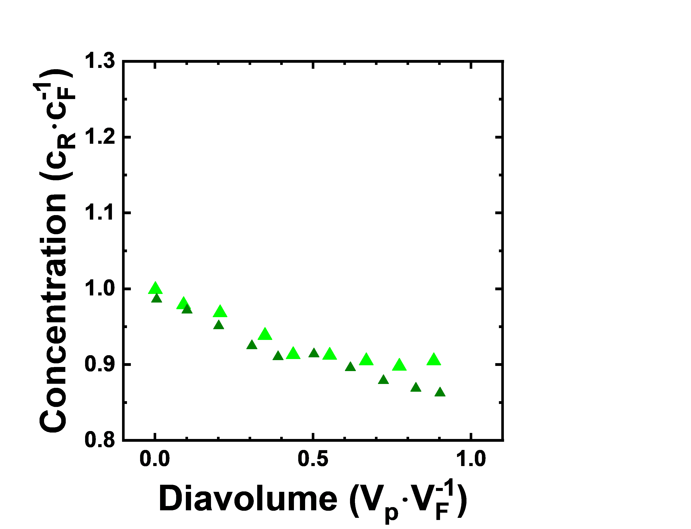
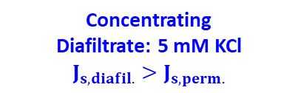
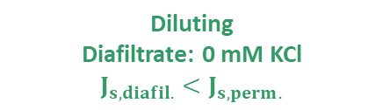

A wide concentration phase space can be explored by carefully designing experimental campaigns
Concentrating
Diafiltrate: 5 mM KCl
$$J_{s,diafil.}>J_{s,perm.}$$
NF270
Critical
Diafiltrate: 1.5 mM KCl
Diafiltrate: 1.8 mM KCl
$$J_{s,diafil.}=J_{s,perm.}$$
Diluting
Diafiltrate: 0 mM KCl
$$J_{s,diafil.}<J_{s,perm.}$$
Conditions | NaCl | LaCl₃ | E11 | E12 | E13 | E14 | E15
Feed | 1mM NaCl | 1mM LaCl₃ | 10mM NaCl | 20mM NaCl | 5mM LaCl₃ | 10mM LaCl₃ | 10mM NaCl & 1mM LaCl₃
Diafiltrate | 150mM NaCl | 20mM LaCl₃ | 5mM NaCl & 15mM LaCl₃ | 10mM NaCl & 15mM LaCl₃ | 50mM NaCl & 0.2mM LaCl₃ | 50mM NaCl & 0.4mM LaCl₃ | 50mM NaCl & 10mM LaCl₃

Slide 7
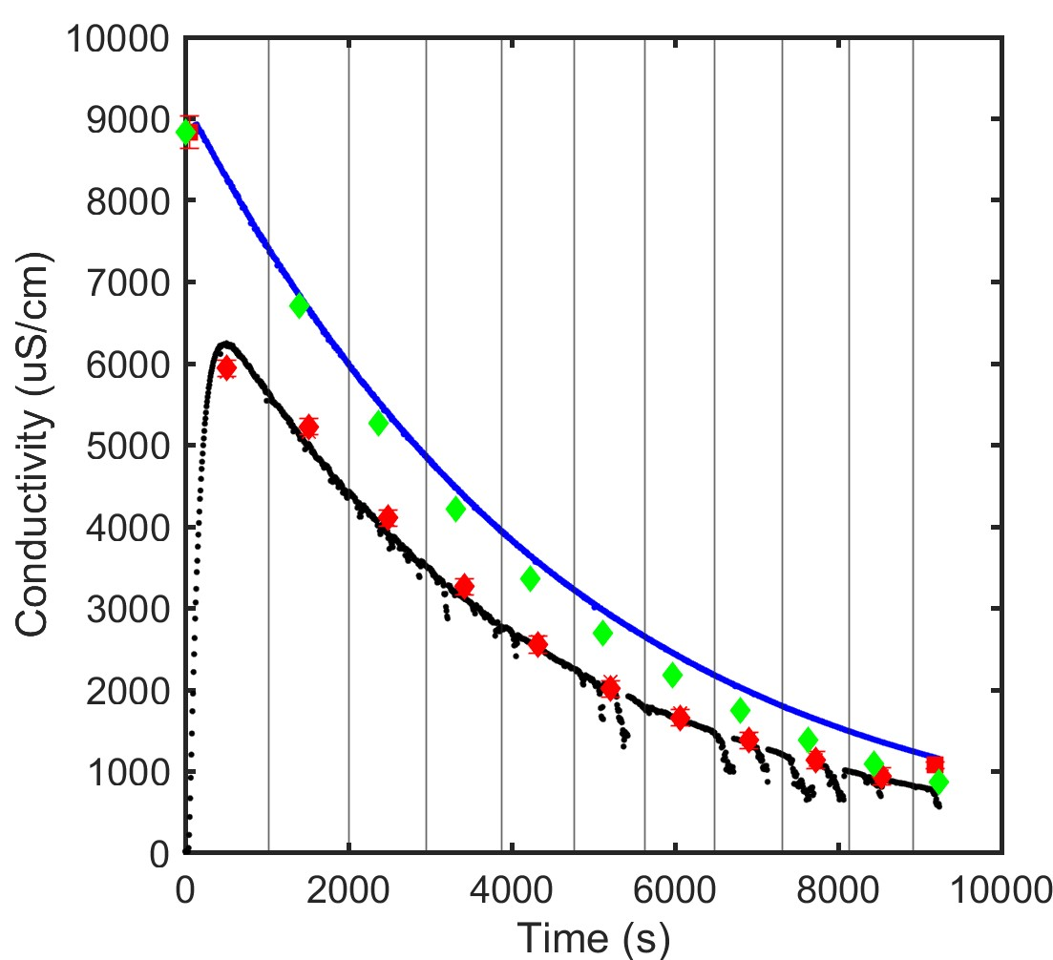
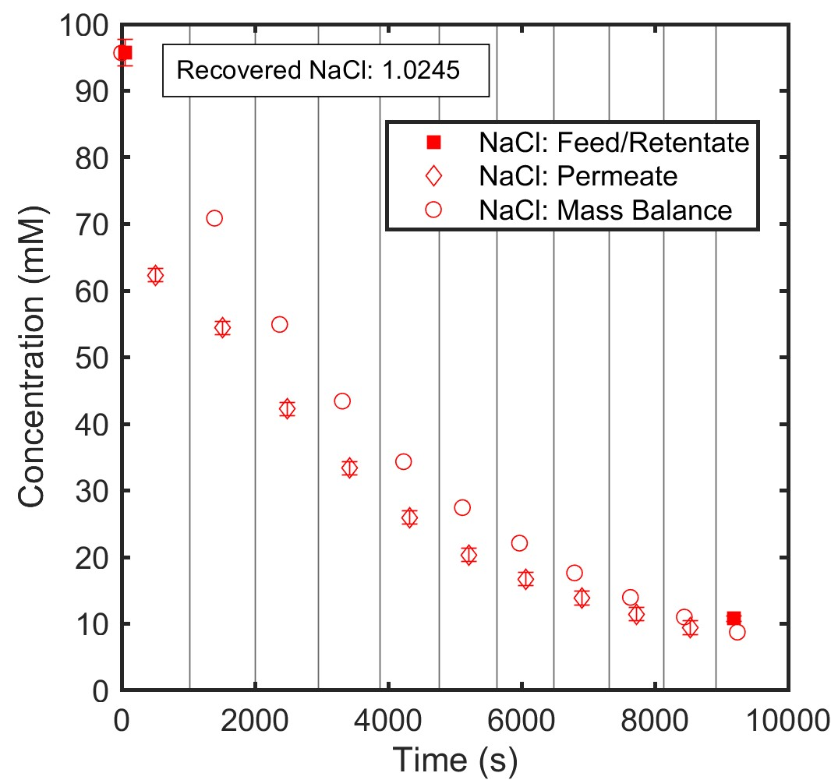
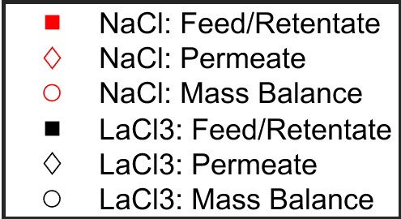
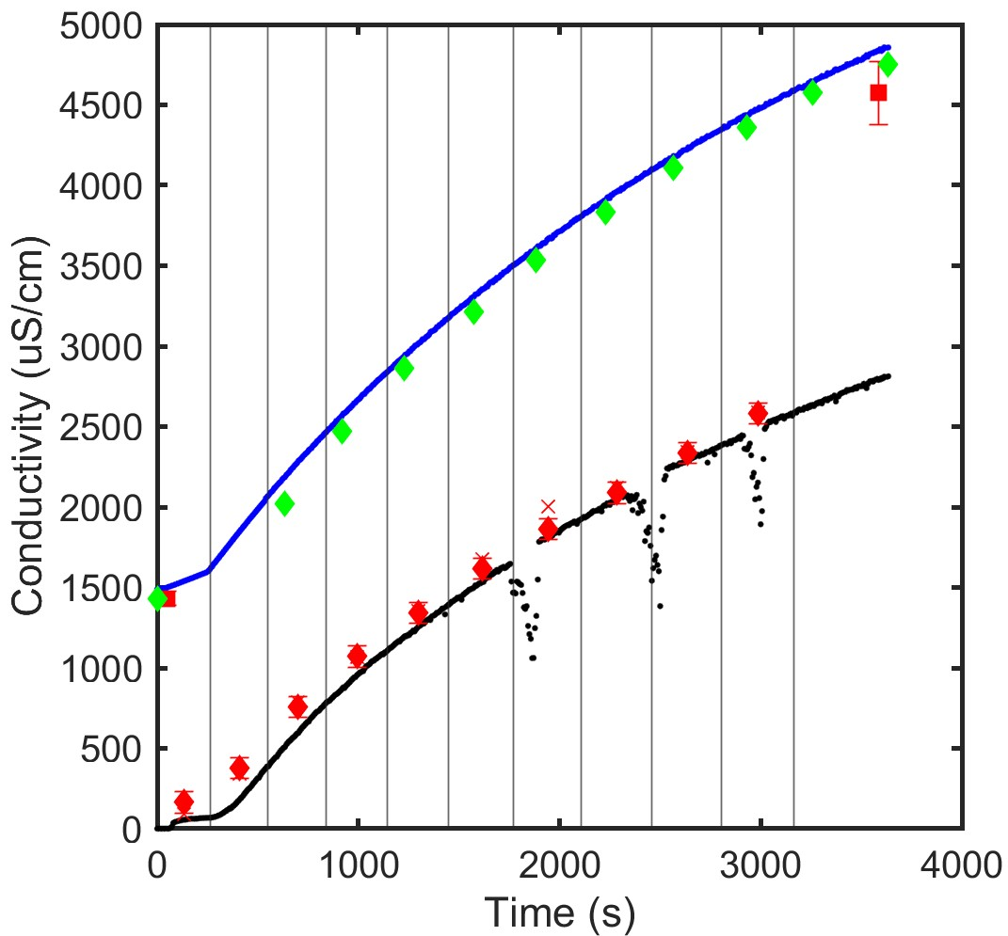
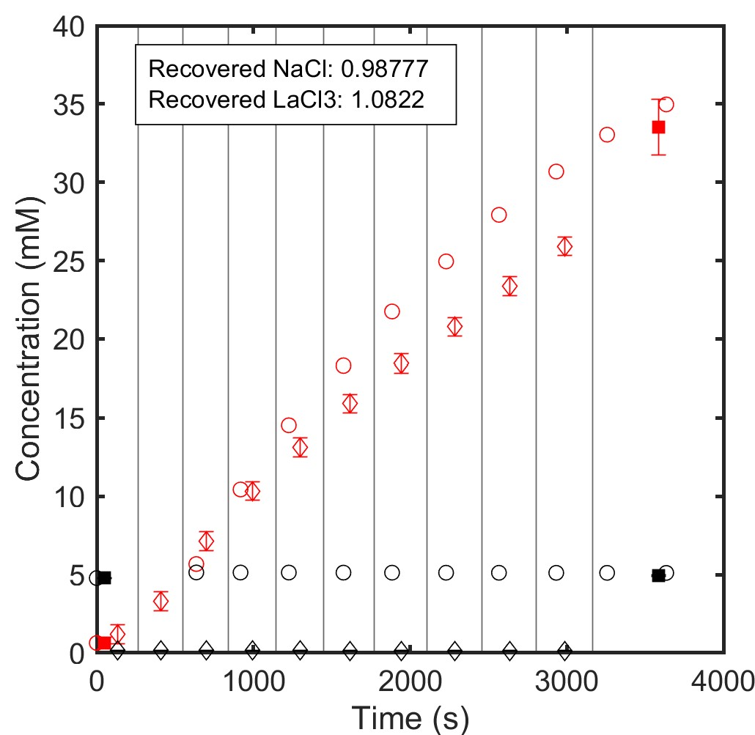
Monovalent ion (Na⁺) rejections decrease from 60% in single salt systems to -100% when present with a competing trivalent ion (La⁺)
Single salt:
150 mM NaCl feed
0 mM NaCl (milliQ water) diafiltrate
Multicomponent (E13):
5 mM LaCl3 feed
0.2 mM LaCl3 + 50 mM NaCl diafiltrate
Preliminary data with KCl and NdCl3 establishes the trends we can expect from NaCl and LaCl3.

